Slide 1
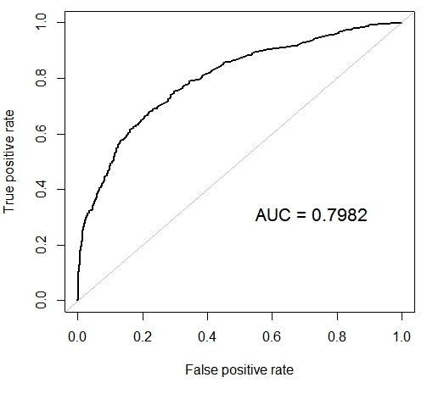
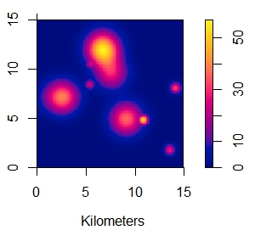
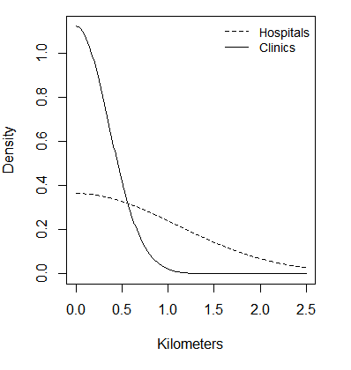
Health Facility Readiness and Facility-Based Delivery in Haiti
Reed Sorensen and Christopher Kemp
Background
Haiti has one of the world’s highest maternal mortality ratios. 380 women die per 100,000 live births. Most of these deaths can be prevented through comprehensive pregnancy and delivery-related care. Nonetheless, use of maternal health services remains low. Only 36% of births take place in health facilities. Increasing use of facility delivery will be critical for Haiti to reduce maternal mortality.
Demand-side factors like socioeconomic status and cultural norms are known to affect women’s propensity to deliver in health facilities. However, analyses of the role of supply-side factors like health facility quality and access have been constrained by limited data and methodological challenges.
Household surveys offer information on population need and use of services. Facility assessments describe the availability and quality of services. The challenge is characterizing health service quality and linking facility data to household data.
Results
Figure 1: Predicted Probability of Facility Delivery by Access to Quality Services and SES
Table 1: Facility Descriptive Statistics (n=389)
Factor | Clinics | Hospitals
N | 295 | 94
Managing Authority
Government/Public | 154 (52.20%) | 41 (43.62%)
NGO/Private Not for Profit | 34 (11.53%) | 13 (13.83%)
Private for Profit | 35 (11.86%) | 30 (31.91%)
Mission/Faith-Based | 72 (24.41%) | 10 (10.64%)
Rural | 220 (74.58%) | 18 (19.15%)
Delivery Readiness Score, mean (SD) | 31.59 (9.89) | 45.48 (8.41)
Table 2: Birth Descriptive Statistics (n=1991)
Factor | Non-Facility Birth | Facility Birth
N | 1252 | 739
Mother's Age, years, mean (SD) | 27.70 (7.20) | 26.84 (6.42)
Mother Married | 915 (73.08%) | 510 (69.01%)
Mother's Education
None | 324 (25.88%) | 65 (8.80%)
Primary | 680 (54.31%) | 251 (33.96%)
Secondary | 247 (19.73%) | 366 (49.53%)
Higher | 1 (0.08%) | 57 (7.71%)
Household Wealth Index, mean (SD) | -5.14 (6.49) | 3.51 (9.61)
Birth Order, mean (SD) | 3.39 (2.38) | 2.23 (1.74)
Readiness Access KDE, mean (SD) | 4.30 (10.31) | 10.64 (15.57)
Research Question
What factors are associated with a woman’s decision to give birth in a health facility in Haiti?
Hypothesis
Giving birth in a health facility is associated with the readiness of nearby facilities to provide delivery-related services, controlling for wealth, education, age, birth order and marital status.
Table 3: Maximum Likelihood Model Estimates
Data
Haiti Demographic and Health Survey 2012
Birth location
Mother’s sociodemographic information
Household wealth index
Haiti Service Provision Assessment 2013
Facility inventory
Provider training history
Parameter | Point Estimate | SE
Logistic Regression
Constant | -1.259 | 0.253
Age | 0.033 | 0.012
Married | 0.016 | 0.122
Socioeconomic Status PCA | 0.890 | 0.059
Birth Order | -0.220 | 0.045
Readiness Access KDE | 0.012 | 0.005
Kernel Density Estimation
σ (Hospitals) | 1.100 | 0.547
σ (Clinics) | 0.356 | 3.968
Distance decay in access to delivery-ready facilities
Methods
Summarize health facility delivery-related service readiness
Create readiness summary score
WHO Service Availability and Readiness Assessment theoretical framework
Describe women’s health service environment
Kernel Density Estimation estimates access to quality services
Health facility readiness scores decay over space
Rate of decay depends on facility type
Estimate association between service environment and facility-based birth
Logistic regression
Coefficients for socioeconomic status (PCA wealth & education), age, birth order, marital status
Bandwidth parameters for kernel density surface; separate estimates for hospitals and clinics
Discussion

